Slide 1

Reputational and influence marketing
Big Data Based Marketing Analytics
Moscow, 2022

Slide 2

Today’s agenda
Master’s Programme
Business Analytics and Big Data Systems
Brand reputation importance
Influencers’ marketing definition, benefits and risks
Reputational marketing tools and methods
The group project description

Slide 3
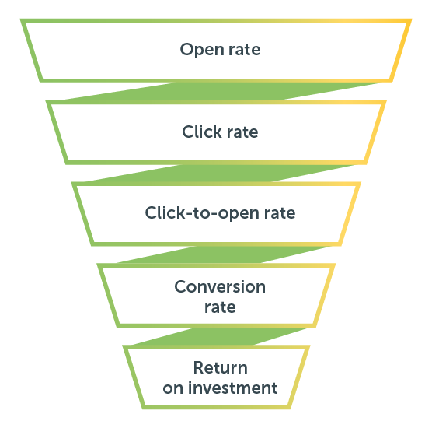

Email campaign main kpis
Master’s Programme
Business Analytics and Big Data Systems
Open rate $=\frac{number of customers who opened email}{number of customers who received email}$
Click rate $=\frac{number of customers who clicked{}_{}^{′}action^{′}button in email}{number of customers who received email}$
Click rate $=\frac{number of customers who clicked{}_{}^{′}action^{′}button in email}{number of customers who opened email}$
C$onversion rate=\frac{number of customers who made a key action}{number of customers who received an email}$
CR can be calculated on every stage of the funnel but to compare CR in target with the CR in control group we need this formula

Slide 4
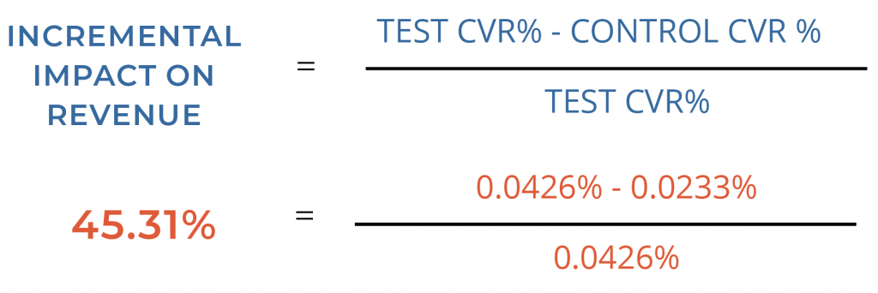
Conversion and financial uplift
Master’s Programme
Business Analytics and Big Data Systems

Slide 5
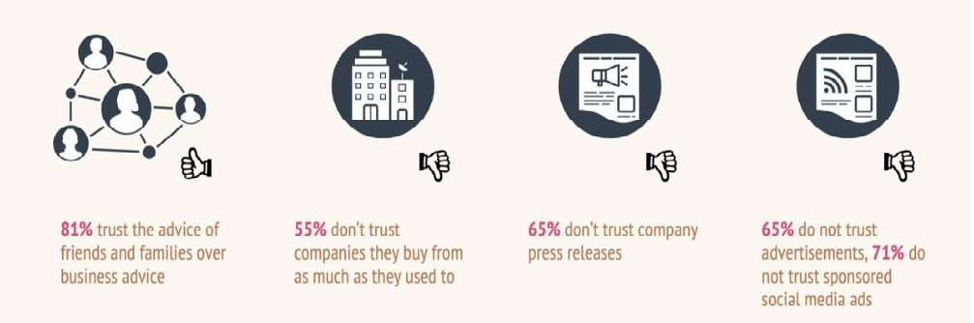
The trust in business has eroded
Master’s Programme
Business Analytics and Big Data Systems
Source: the survey of UK and USA customers, 2019

Slide 6
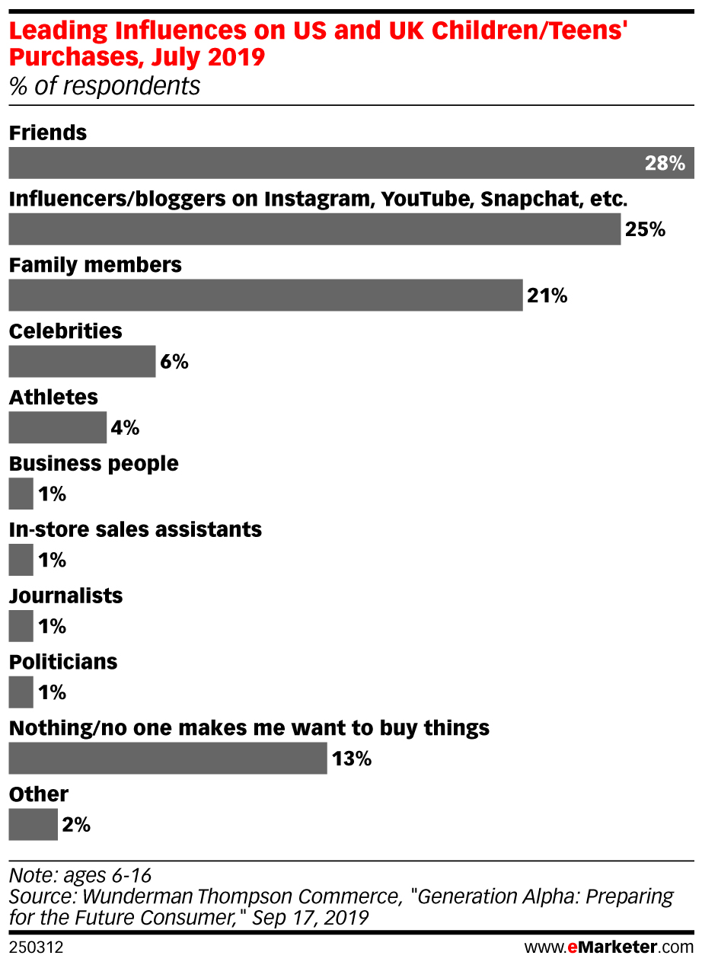
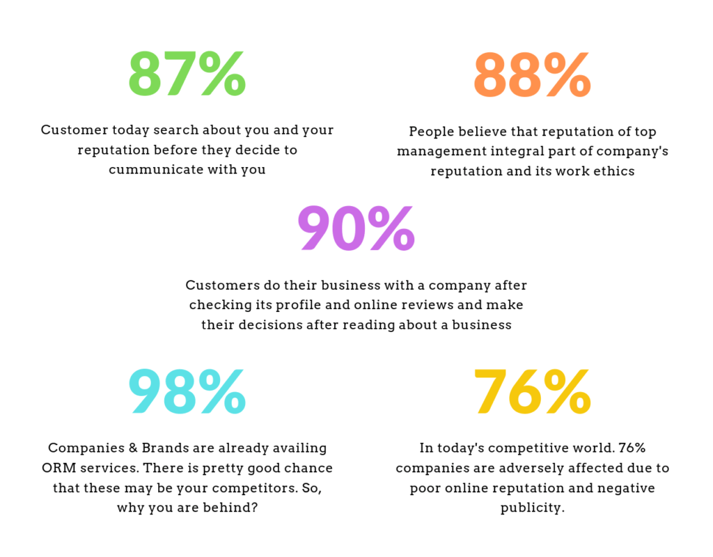
What FACTORS influence A purchase?
Master’s Programme
Business Analytics and Big Data Systems

Slide 7
Why reputation is crucial?
Master’s Programme
Business Analytics and Big Data Systems
Story 1
You‘ve spent 100K dollars on ads in search engine. Your ad places with ads of your three competitors – on the side of organic search results. But the second and the seventh links lead on the site of angry client and have title “Your brand – bullshit”.
How much does your lead advertising campaign costs? How much money did you lose? Which part of potential audience will use ad links of competitors?
How much people went to read negative reviews?
Story 2
You’ve spent 5 mln dollars on the development and launch of a new product. Two grumpy customers post negative reviews on Amazon. They are followed by other negative mentions. After 125 comments the average rating was 1,5 stars (1 star is the lowest rating). One of those grumpy customers left reviews on three other sources. Customers don’t come to you anymore.
How fast will this product “die”? How much investments were wasted because we were not ready for negative reviews? Which effect will it have on your other products?

Slide 8
Why reputation is crucial?
Master’s Programme
Business Analytics and Big Data Systems
Story 3
You pay for e-mail communication on million addresses those who (how you think) agreed to receive information from you. 1% follows the link, and 10% from them buy your product. So, you get 1 000 new customers.
But 10 000 people don’t remember that they allowed using their address. They get angry and decide not to do business with you. And they tell their friend that you spammed them.
Over 2,000 of them were existing customers and now they are angry with you. Everyone tells five friends about it.
How many potential customers have you lost forever?

Slide 9
The brand reputation management (ORM)
Master’s Programme
Business Analytics and Big Data Systems
Step 1: Monitor brand’s/ company’s reputation Know WHAT customers, influencers, competitors say about the brand/product
Step 2: Devise a response plan Consider:
Who will monitor for comments and reviews?
Who decides whether new comments require a response?
Who knows what position the company should take regarding potential issues or questions?
Who will deliver the response?
Step 3: Handle negative comments delicately
Step 4: Build on the positives
Step 5: Follow through and measure your results

Slide 10
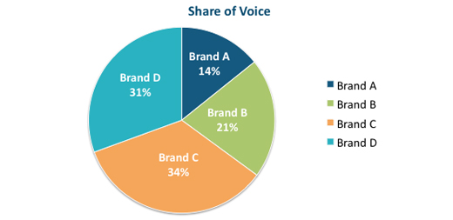
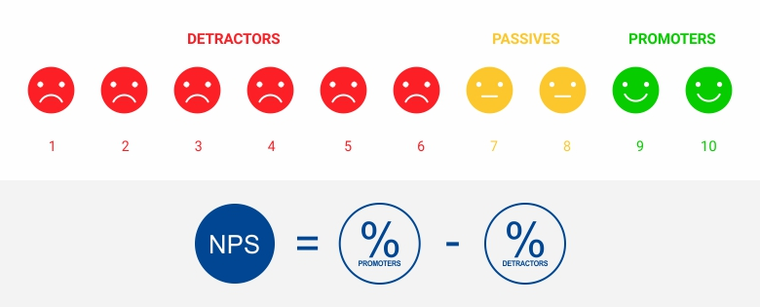
The reputational metrics
Master’s Programme
Business Analytics and Big Data Systems
SOV = Your brand’s measures / Total market measures
NPS - difference between % of promoters and % of detractors

Slide 11
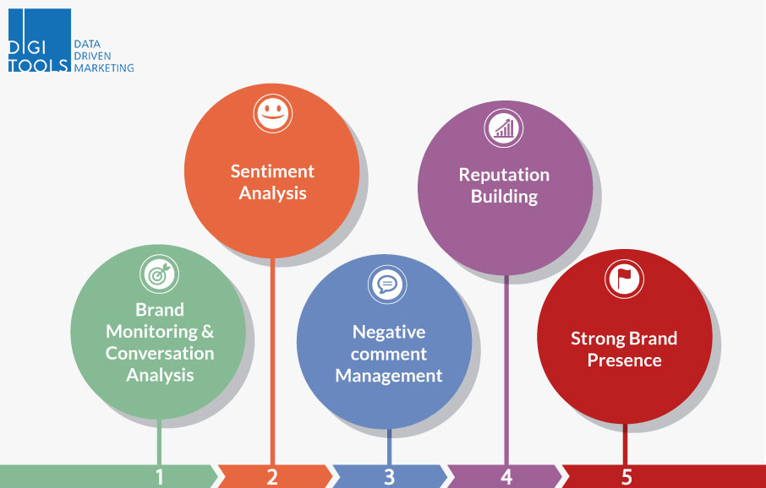
The milestones of reputation management
Master’s Programme
Business Analytics and Big Data Systems

Slide 12
The tools for reputation management (ORM)
Master’s Programme
Business Analytics and Big Data Systems
Reputation tools scan search results, social networks, review pages to looking for mentions in articles or other websites and grab all relevant mentions
2 types of online reputation management (ORM) tools:
monitoring tools - tell you when a problem may be occurring
Management tool - helps to solve a problem once it has occurred

Slide 13
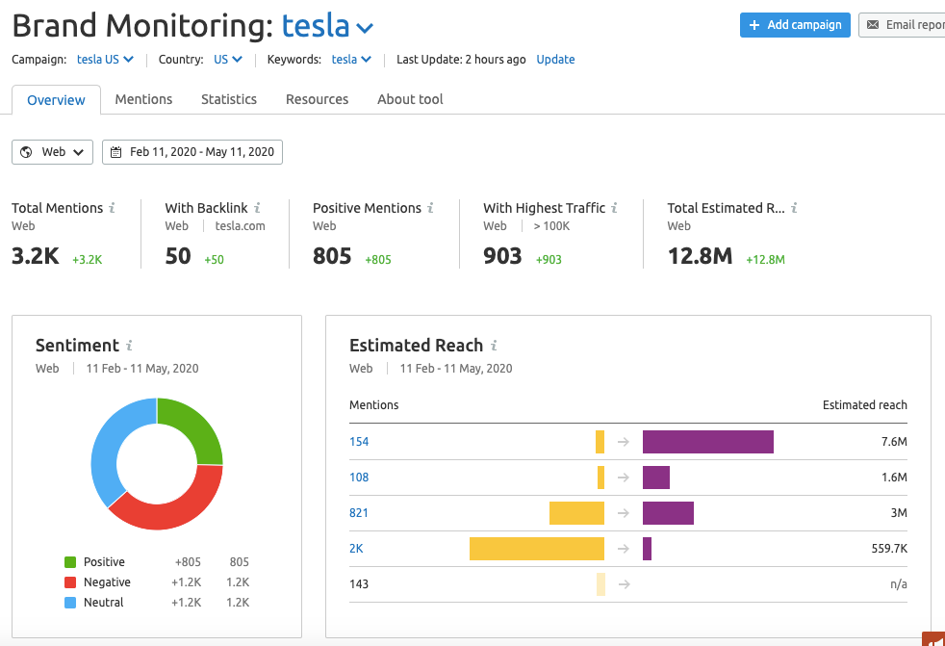
The tools for reputation management (ORM)
Master’s Programme
Business Analytics and Big Data Systems

Slide 14
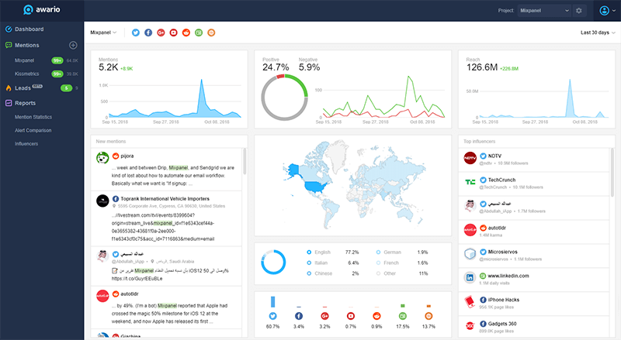
The tools for reputation management (ORM)
Master’s Programme
Business Analytics and Big Data Systems

Slide 15
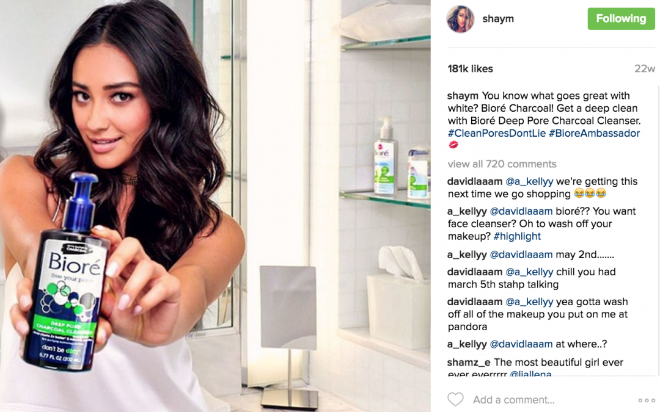


Influence marketing
Master’s Programme
Business Analytics and Big Data Systems
All about businesses paying social media influencers to promote their products to prospective customers
Influencers are thought leaders within a particular niche and come with massive social media following from loyal fans

Slide 16
What influencers can do for the brand?
Master’s Programme
Business Analytics and Big Data Systems
influencers are more approachable You can rope in one or more within your niche and they can boost your brand awareness in several ways:
Generating brand awareness among a new audience segments
Bringing credibility to your brand via their already-established follower relationships
Creating a snowball effect regarding your brand in social media
Boosting your search engines ranking
Driving conversion by including click-to-buy calls to action within their posts
Generating brand awareness among a new audience segments

Slide 17
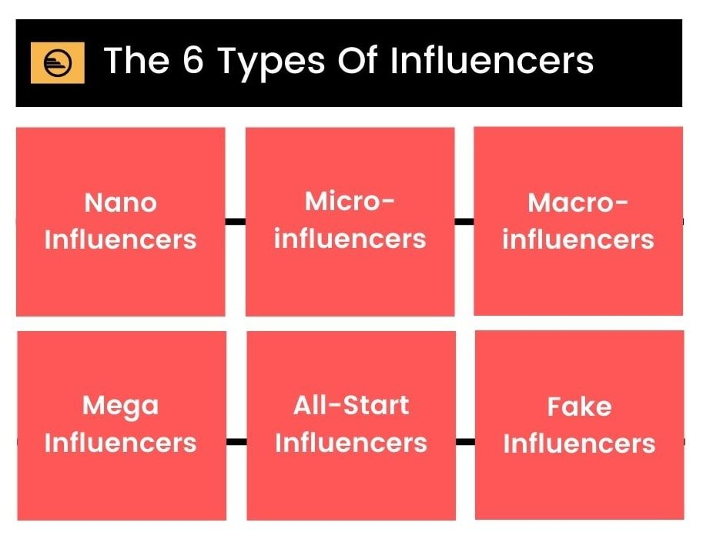
The types of influencers
Master’s Programme
Business Analytics and Big Data Systems
Employees
Customers
Nano Influencers: <1K to 10K
Micro Influencers: 10K to 100K
Macro Influencers: 100K to 1M
Mega Influencers / Celebrities / Public figures: >1M

Slide 18
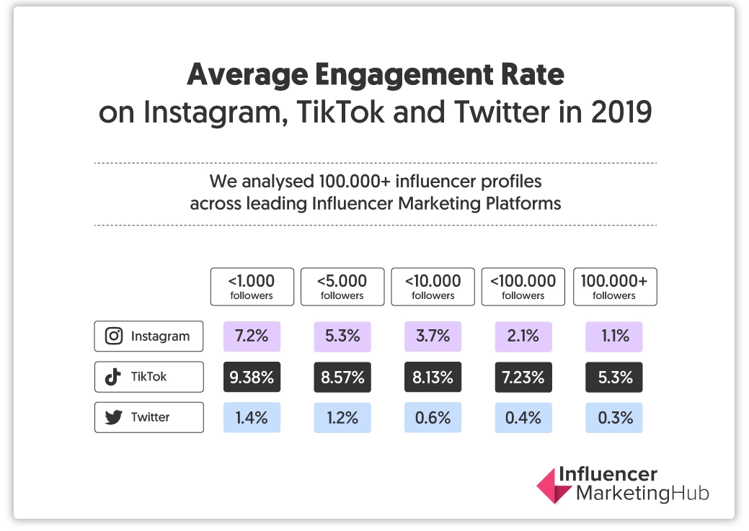
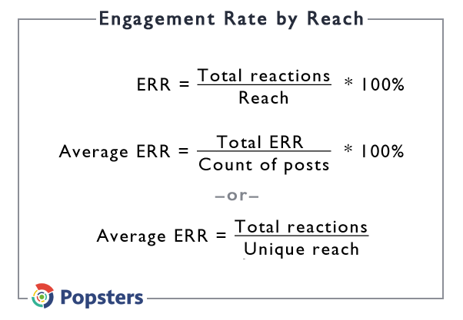
The types of influencers (based on number of followers)
Master’s Programme
Business Analytics and Big Data Systems

Slide 19
How to choose a right influencer?
Master’s Programme
Business Analytics and Big Data Systems
Analyze your target audience. What platforms do the use?
The influencers’ main topic and audience structure. Do they match your target audience?
Look at the metrics: - stable growth of audience size - reach and engagement of posts - content engagement rate - the quality and sentiment of comments
Analyze the influencer’s content: - authenticity, passion, and knowledge
Compare influencer’s price with the budget

Slide 20
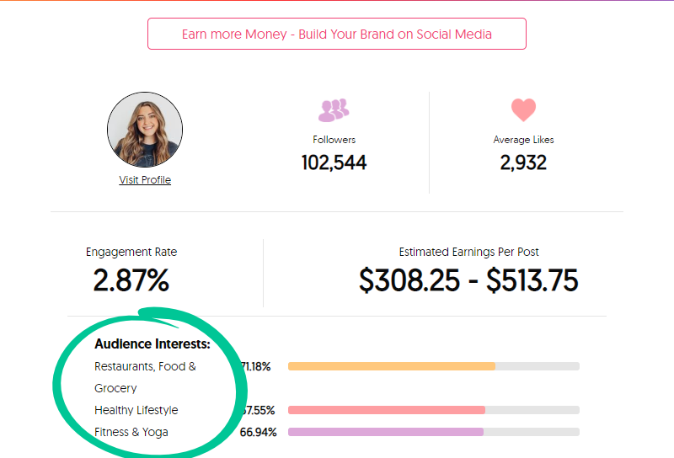
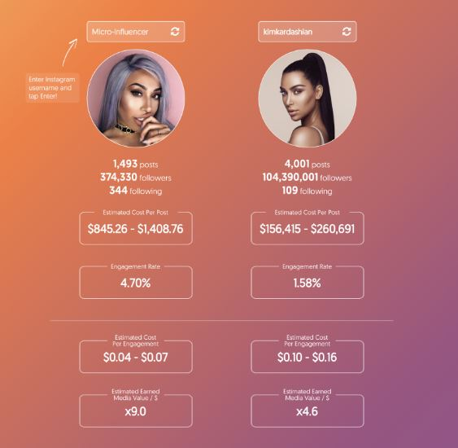
How to choose a right influencer?
Master’s Programme
Business Analytics and Big Data Systems

Slide 21
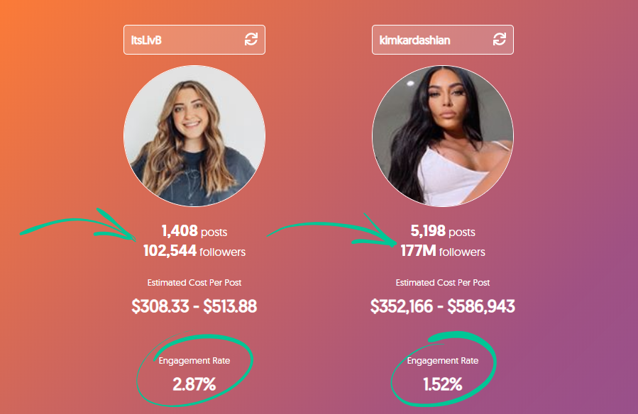
Bigger audience doesn’t mean higher campaign results
Master’s Programme
Business Analytics and Big Data Systems

Slide 22
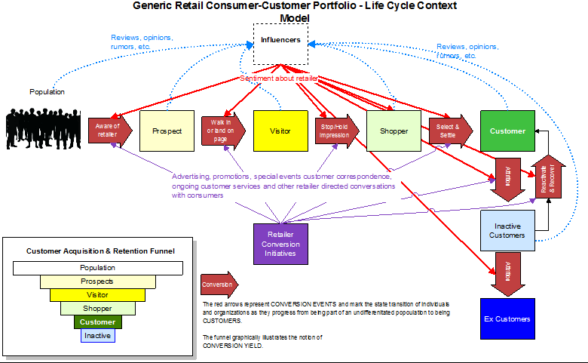
The role of. Influencers in clm
Master’s Programme
Business Analytics and Big Data Systems

Slide 23
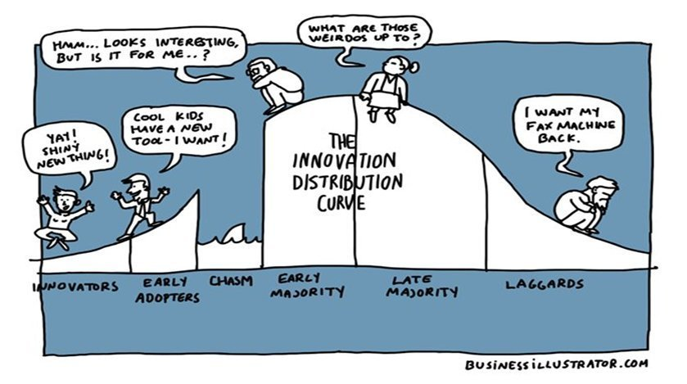
The innovation diffusion
Master’s Programme
Business Analytics and Big Data Systems

Slide 24
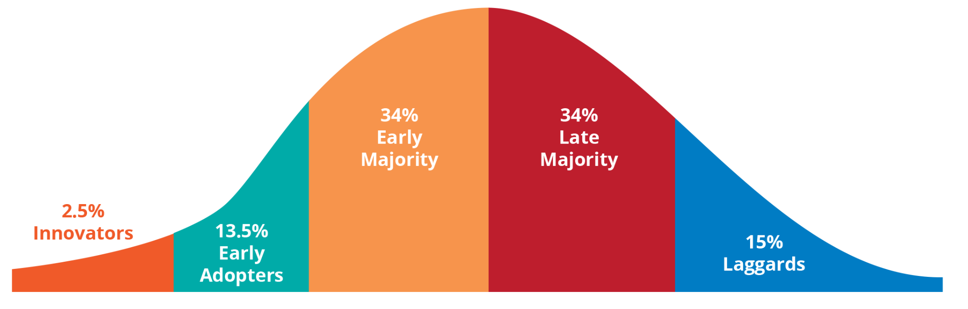
The innovation diffusion
Master’s Programme
Business Analytics and Big Data Systems

Slide 25
The innovation diffusion
Master’s Programme
Business Analytics and Big Data Systems
Marketing strategy is concentrated on early majority and late majority

Slide 26
The innovation diffusion
Master’s Programme
Business Analytics and Big Data Systems
Product launch - for innovators and early adopters

Slide 27
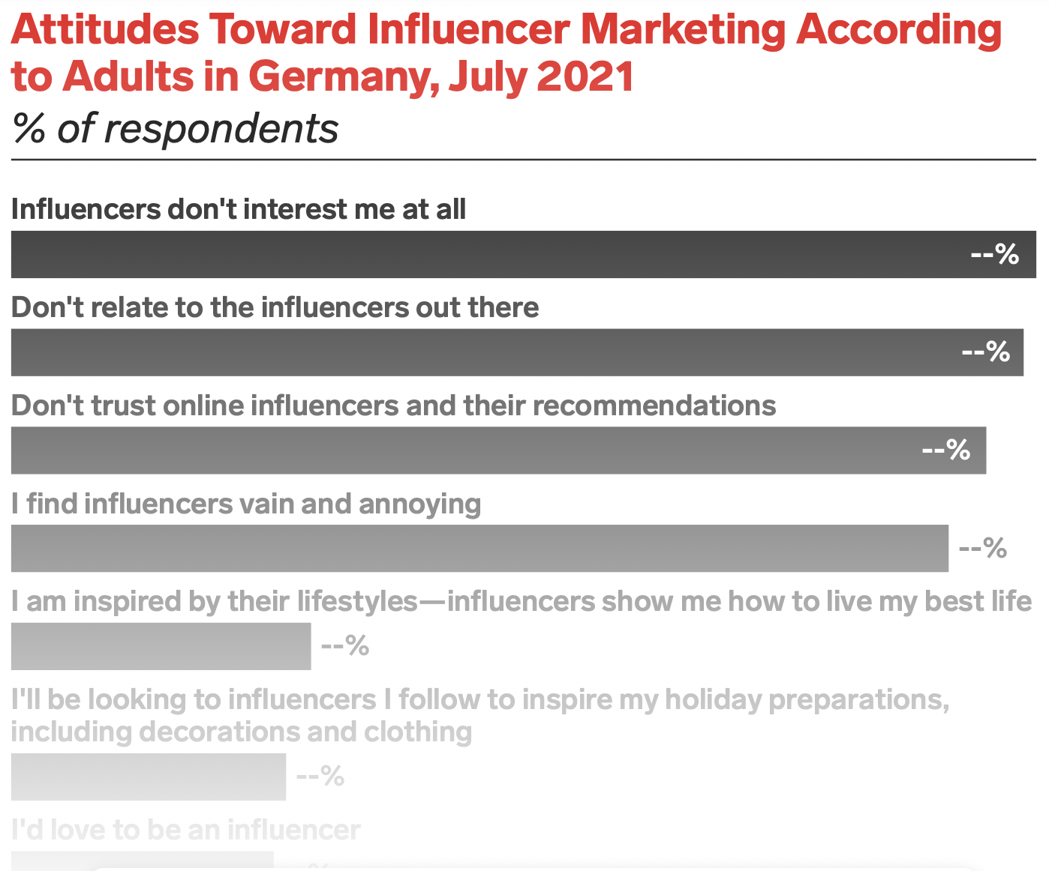
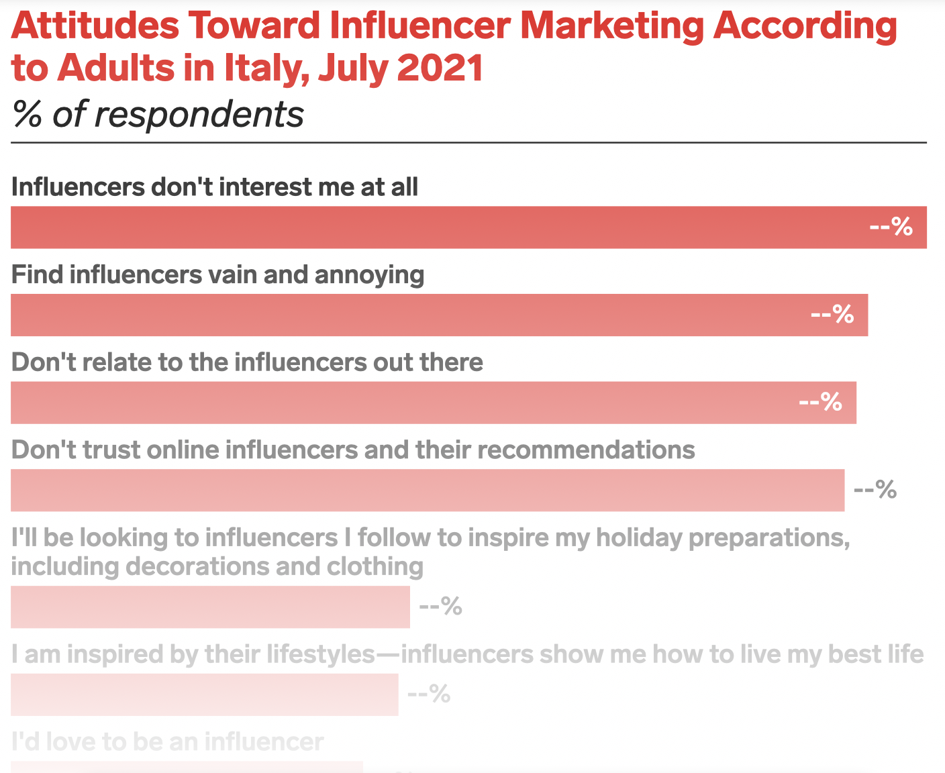
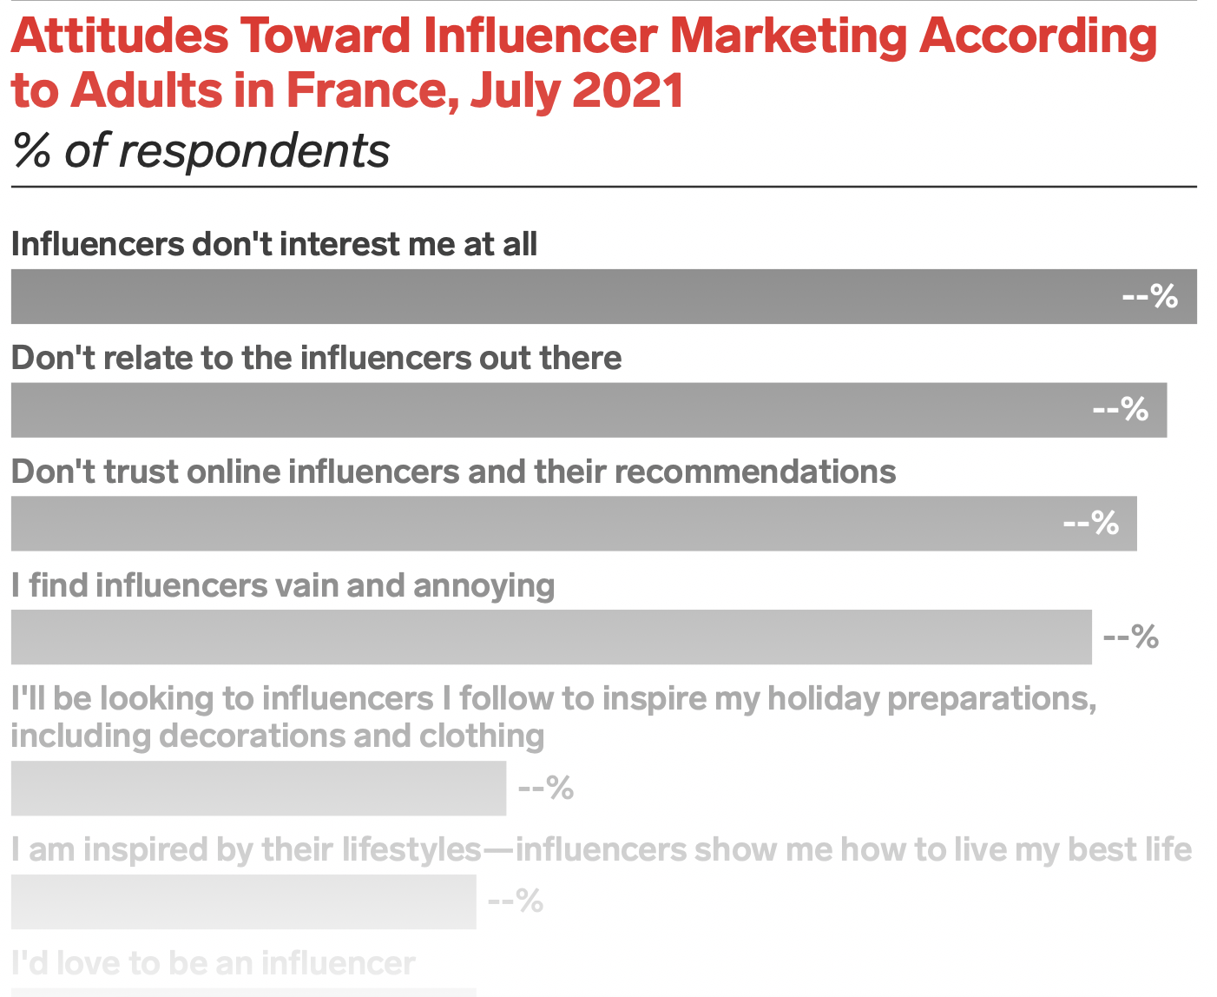
The attitude toward influencer marketing
Master’s Programme
Business Analytics and Big Data Systems
Source: eMarketer

Slide 28
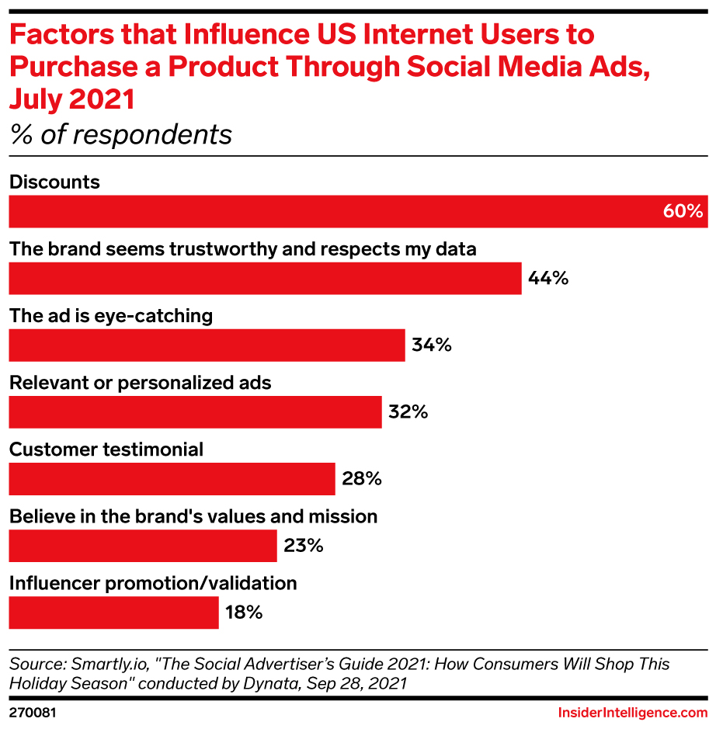
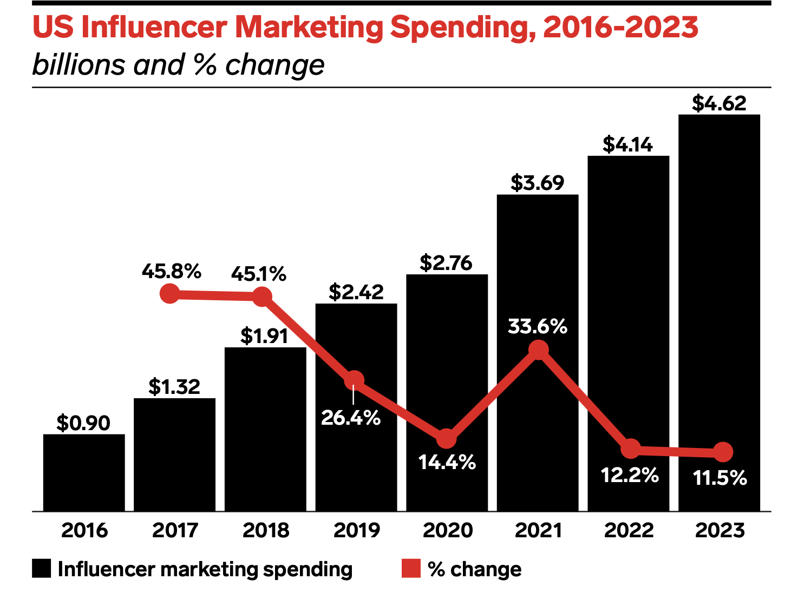
The changes in spending on influence marketing
Master’s Programme
Business Analytics and Big Data Systems
Source: eMarketer

Slide 29
The group project description
Master’s Programme
Business Analytics and Big Data Systems
The project is made in groups of 4-5 students
The deadline – 13th of December, 23:59. Presentations will be held on 14th of December
The goal – to analyze brand/product/company reviews, compare with the competitors’ results and write the recommendations
Materials to be prepared:
the initial (after parsing) and preprocessed datasets with reviews,
Colab / Jupiter notebook
slides with the research results, conclusions and recommendations

Slide 30
The group project description
Master’s Programme
Business Analytics and Big Data Systems
Choose a product or an industry. Explain why you’ve chosen it
Parse the data from websites with reviews (e.g. using chrome plugins) - review date - review text - review or product rating (if there is any) - author account name, info about the product and etc.
Translate the reviews into English if needed
Make the data preprocessing
Perform semantic analysis, calculate the reputational metrics
Perform the topic modeling, identify the key topics
Make the conclusions about the brand/product/company reputation, the tone of voice, compare with the competitors or the industry benchmarks

Slide 31
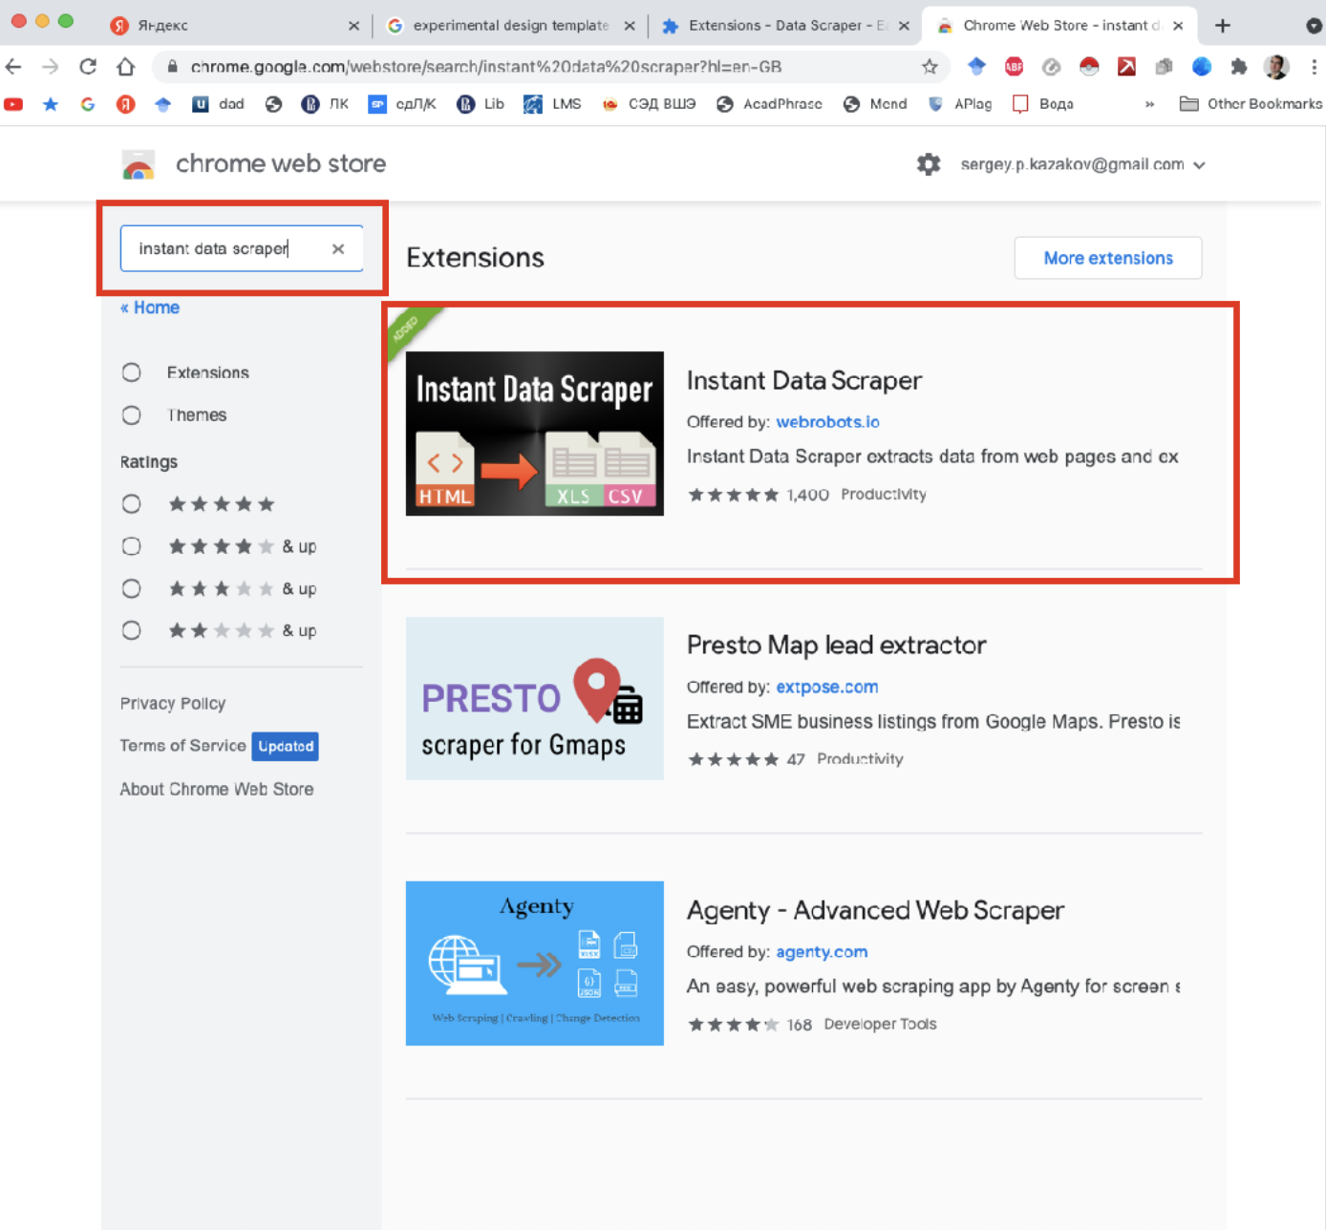
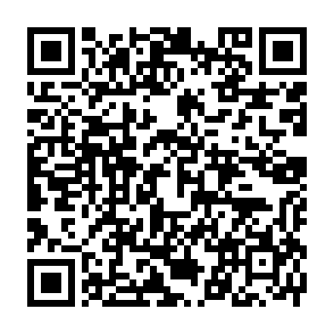
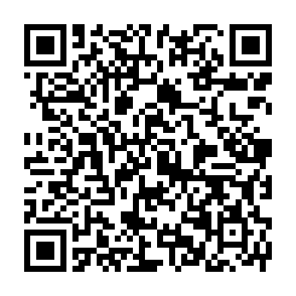
Web scrapping tools
Master’s Programme
Business Analytics and Big Data Systems
Instant Data Scraper
Table Capture

Slide 32
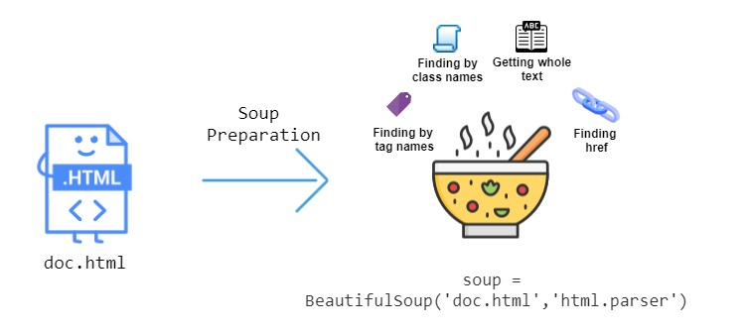
The beautiful soup library for web scrapping
Master’s Programme
Business Analytics and Big Data Systems
! pip install beautifulsoup4
from bs4 import BeautifulSoup
soup.find_all("a", class_="element")

Slide 33
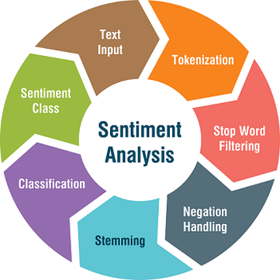
The beautiful soup library for web scrapping
Master’s Programme
Business Analytics and Big Data Systems

Slide 34
The review data preprocessing tips
Master’s Programme
Business Analytics and Big Data Systems
Remove URLs, emails, phone numbers & punctuations
Remove tags, emojis, symbols & pictographs
Remove stop words
Convert to lowercase and lemmatization
Duplicates removal
Spell checking
Non-English reviews translation/removal Translation can be made here: https://www.onlinedoctranslator.com/ru/translationform
Original review: {'It has all the boring movies and episodes'} Preprocessed review: {'boring movie episode'}

Slide 35
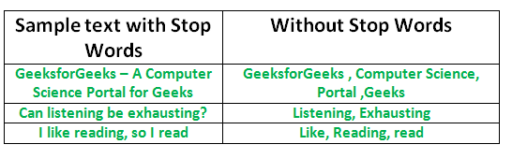
Stop words
Master’s Programme
Business Analytics and Big Data Systems
Stop words are words that may be important in human communication but are of little value for machines and review analysis
‘ourselves’, ‘hers’, ‘between’, ‘yourself’, ‘but’, ‘again’, ‘there’, ‘about’, ‘once’, ‘during’, ‘out’, ‘very’, ‘having’, ‘with’, ‘they’, ‘own’, ‘an’, ‘be’, ‘some’, ‘for’, ‘do’, ‘its’, ‘yours’, ‘such’, ‘into’, ‘of’, ‘most’, ‘itself’,
Can use NLTK or spaCy library

Slide 36
lemmatization
Master’s Programme
Business Analytics and Big Data Systems
A huge variety of libraries:
Wordnet Lemmatizer
Spacy Lemmatizer
TextBlob
CLiPS Pattern
Stanford CoreNLP
Gensim Lemmatizer
TreeTagger
Notes:
https://colab.research.google.com/drive/15HE8HEQjcPMi0c-vZ40OCU2L1nCFcIbm?usp=sharing

Slide 37
lemmatization
Master’s Programme
Business Analytics and Big Data Systems
# libraries:
from nltk.stem import WordNetLemmatizer
lemmatizer = WordNetLemmatizer()
print("rocks :", lemmatizer.lemmatize("rocks"))
print("corpora :", lemmatizer.lemmatize("corpora"))
# a denotes adjective in "pos"
print("better :", lemmatizer.lemmatize("better", pos ="a"))
rocks : rock
corpora : corpus
better : good

Slide 38
lemmatization
Master’s Programme
Business Analytics and Big Data Systems
# libraries:
from nltk.stem import WordNetLemmatizer
lemmatizer = WordNetLemmatizer()
print("rocks :", lemmatizer.lemmatize("rocks"))
print("corpora :", lemmatizer.lemmatize("corpora"))
# a denotes adjective in "pos"
print("better :", lemmatizer.lemmatize("better", pos ="a"))
rocks : rock
corpora : corpus
better : good
Notes:
https://drive.google.com/file/d/1lDQX2vrNFfdKBz2kg_f5hEpccWDkc-PE/view?usp=share_link
https://colab.research.google.com/drive/1MAkTP2HgqoK7mEA7_NANroMw0QVzfq20?usp=sharing

